Slide 1
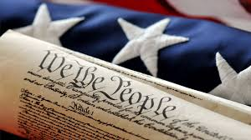
U.S. History
StaAr Tested content
We will cover foundations of America
Then Post-reconstruction to Current history
Current Teachers:
Coach Haire
Ms. Southard
Coach Clemente
Dr. Adkins

